Slide 1
Biol 465 Immunology Lab 4
Introduction to Fluorescence Activated Cell Sorting
(FACS/Flow Cytometery)

Slide 2
Flow cytometry is one of those amazing applications of the normal behavior of antibodies.
In this technique antibodies are used to bind to specific antigen. The antibodies are fluorescently labeled for detection. The antibodies detect antigen on or in cells.

Slide 3
Microscope view (Fluorescence microscopy)

Slide 4
Flow (FACS) uses a sophisticated machine to “see” fluorescence of different wavelengths using lasers and mirrors to detect different features about individual cells.

Slide 6
Most of the time, a FACS machine is used to analyze samples without collecting cells of different types.
For example, you might be interested to know if a person has normal numbers of B-cells. FACS might be used to measure B-cell levels, without keeping cells at the end of the analysis.

Slide 7
FACS can also be used to actually sort cell populations as well. Cells of different types are identified by their expression of different antigens (detected by antibodies).

Slide 9
Antibodies
You know a bit about antibodies:
Their basic shape
The part that binds to antigen
The unique shape and antigen affinity for each kind of antibody
That antibodies are produced by B-cells

Slide 11
In technology like FACS, antibodies must be produced and collected from organisms producing those antibodies.
The process is essentially the same as when we develop humoral immunity naturally.
The organism is exposed to an antigen, and given time to develop an adaptive response.

Slide 13
Serum is collected and tested to see if it binds to the original (immunizing) antigen.
We assume that the serum contains a collection of antibodies which may bind different parts of the same antigen. We call this collection polyclonal antibodies. They are produced by different B-cells.

Slide 14
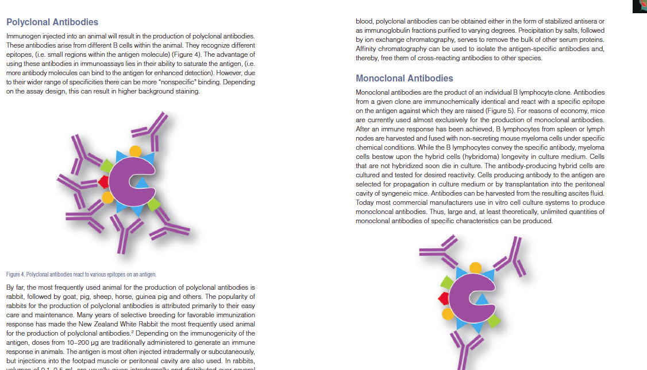
Screen Shot 2013-09-19 at 10.09.33 AM

Slide 15
Sometimes it’s important to collect a single type of antibody---that sees just one aspect of the antigen.
We call these monoclonal antibodies. They come from a single clone of B-cells.

Slide 16
Screen Shot 2013-09-19 at 10.09.33 AM

Slide 17
A source of monoclonal antibodies can be maintained by culturing the B-cells that produce them.
The B-cells of interest are fused with tumor cells to make them immortal. The new cell is called a hybridoma.

Slide 18
As long as the B-cell/hybridoma grows and divides in culture, monoclonal antibodies will be secreted into the cell culture media.

Slide 20
Back to FACS analysis.
In a FACS experiment, antibodies of different specificities are used to distinguish one cell type from another in a mixed sample.
In order to “find” that one cell type, the antibodies must be bound to it. This is done before the sample is put in the FACS machine and is referred to as “staining the cells”

Slide 21
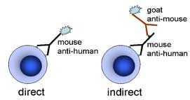
Two types of antibody staining
1. Direct staining---the antibody is linked to a fluorescent molecule (fluorophore) giving the cell the characteristic of fluorescence.
In this example, an antibody was produced in a mouse that binds to an antigen on a human cell.

Slide 22
2. Indirect staining---uses 2 antibodies. One (primary antibody) binds directly to the antigen of interest. The antibody is not labeled.
A second antibody (secondary) is designed to bind to the primary antibody. The secondary antibody is fluorescently labeled.

Slide 23
Indirect staining

Slide 24
Indirect staining is more common. It allows the use of one type of secondary antibody for all staining procedures. Since it is expensive to link fluorphores to antibodies, it makes staining cheaper.
--For example, the goat-produced antibody in the figure, would bind to any antibody made in mouse. It binds to a part of the antibody that is the same in all antibodies.

Slide 25
How does FACS work?
The machine detects various aspects of light.
Forward light scatter
Side light scatter
Specific emission wavelenth from the fluorophore

Slide 28
FSC
Forward scatter relates to the volume/size of the cell. A population of cells can have widely different sizes which will show up as a wide degree of forward scatter.
Conversely, a semi-pure population of cells will have a fairly narrow degree of forward scatter.

Slide 29
SSC
Side scatter reveals internal complexity (size of nucleus or presence of granules etc.) SSC also reveals membrane roughness.

Slide 30
How many populations?

Slide 31
Data—dot plots

Slide 32
Specific antigen detection
A sample used for analysis may have a number of different cell types that look the same with regard to FCS and SSC. As mentioned before, specific antibodies help sort out specific cell types.
Many specific cell surface antigens are known to define specific cell types.

Slide 33
For example--- T- Lymphocytes all express CD3
CTLs express CD8
T_{H} cells express CD4
Samples can be stained for CD4 and CD8 simultaneously.

Slide 36
Making limits for cell classification

Slide 37
Gating
FACS machines even allow you to take a first look at a cell sample by FSC/SSC and select a population to analyze further.

Slide 38
Subpopulation gated out from the rest and analyzed with specific antibodies.

Slide 39
Our application…
Today we will analyze some FACS data from TPA/PMA treated cells. In an experiment such as the one you have done over the past week, the cells changed dramatically in growth (division) rate and in morphology---cell shape.
A logical guess is that they have differentiated/matured into macrophages

Slide 40
A way to test that guess is to test for expression of macrophage-specific cell surface antigens---Using FACS.

